Slide 1







Power
Saturday
6 juin 2020, Online
Une conférence des communautés Club Power BI, GUSS, aOS

Slide 2
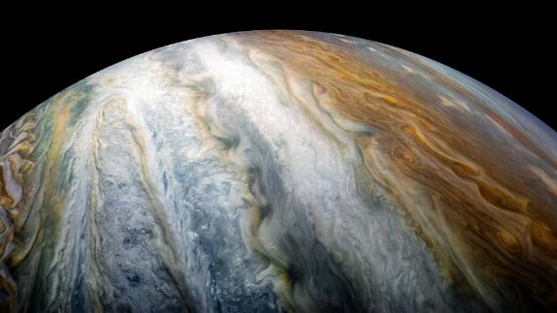
Notebooks in Azure Data Studio for the DBA
Rob Sewell

Slide 3


Slide 4

Rob Sewell
Consultant
MVP and Beard Twizzler
@SqlDbaWithBeard
beard.media/book – 40 % code twitsewe40
Slides and Code beard.media/presentations
https://beard.media/Notebooks

Slide 5
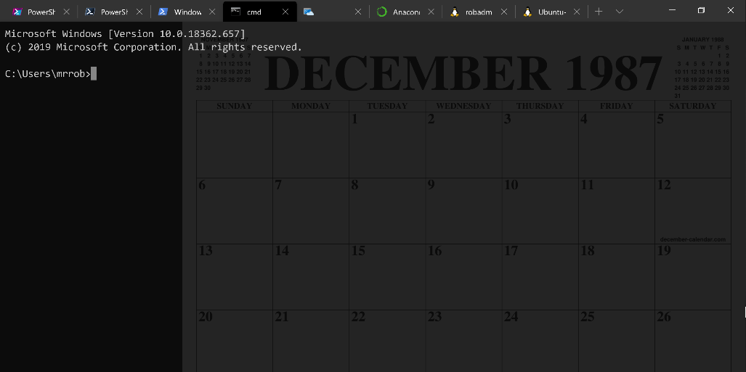
Running Queries

Slide 7
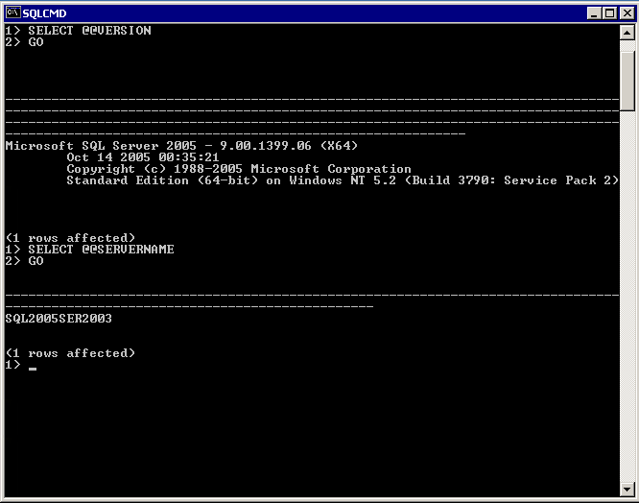
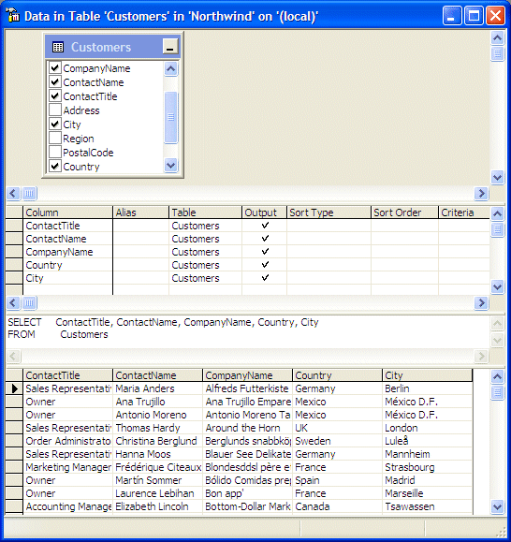

Slide 8
Two and a Half Decades

Slide 9
Uh, Houston, we've had a problem
https://en.wikipedia.org/wiki/Houston,_we_have_a_problem

Slide 10
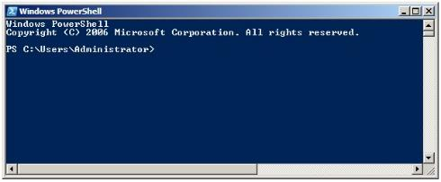
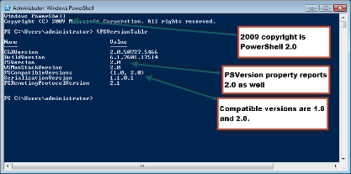
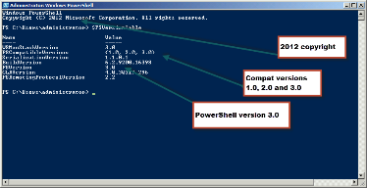
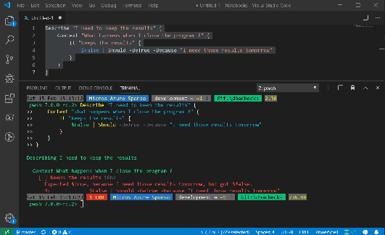
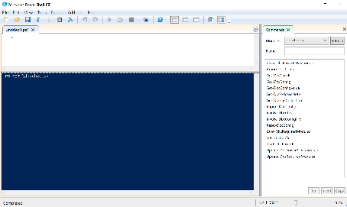
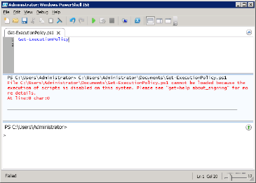
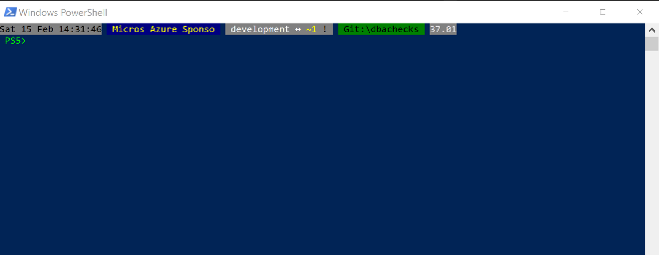
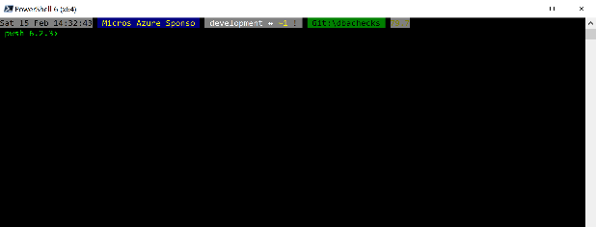
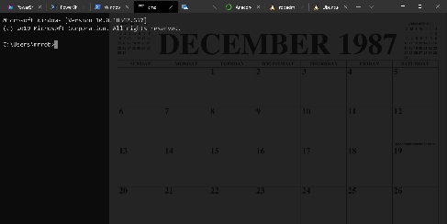
Without some effort………..

Slide 11
Without some effort………..

Slide 12
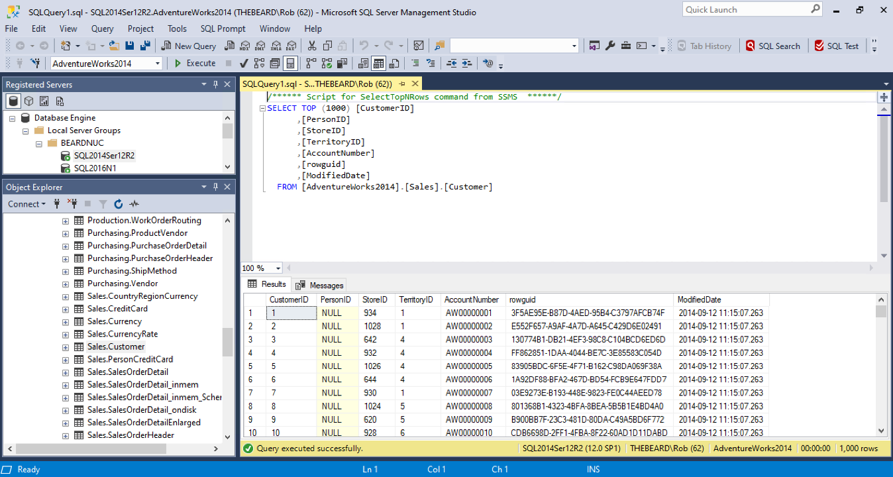

Slide 13
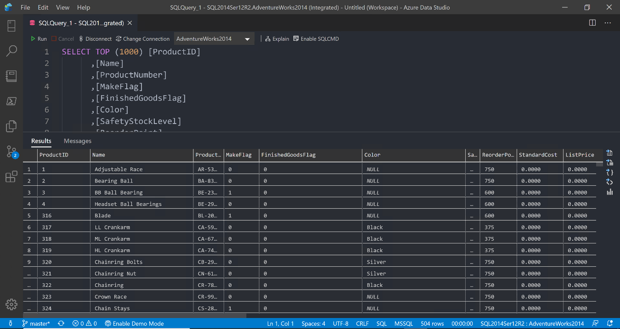

Slide 14
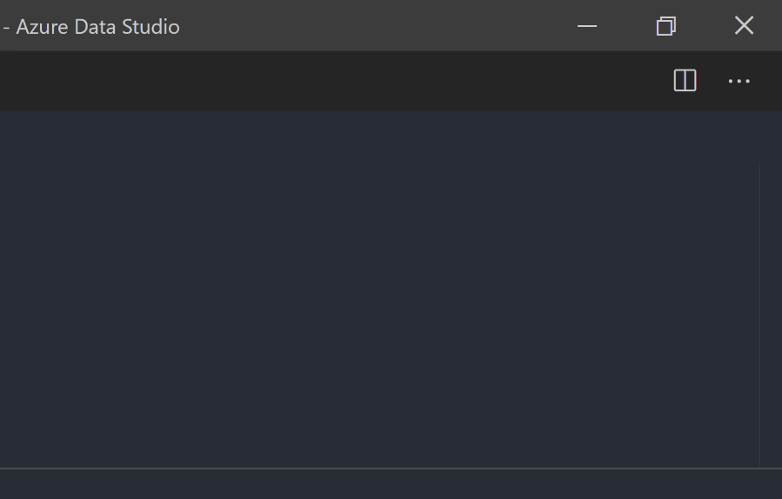

Slide 15


Slide 16


Slide 17
ALL
GONE

Slide 18
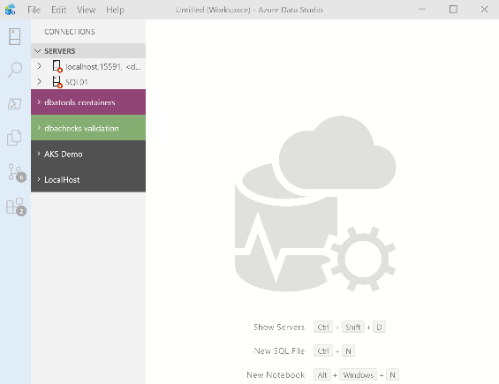
What’s Azure Data Studio ?
Cross Platform desktop environment for Data Professionals

Slide 19

So it’s only for Azure?

Slide 20
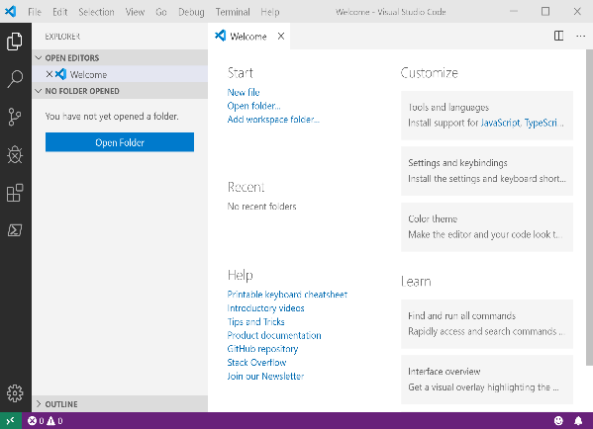
It Looks Like Visual Studio Code ?

Slide 21
It Looks Like Visual Studio Code ?

Slide 22


Slide 23
Jupyter

Slide 24
Jupyter
First, the name comes from the planet Jupiter. We wanted to pick a name that evoked the traditions and ideas of science.
https://github.com/jupyter/design/wiki/Jupyter-Logo

Slide 25
Jupyter
Second, the core programming languages supported by Jupyter are
Julia, Python and R.
While the name Jupyter is not a direct acronym for these languages, it nods its head in those directions.
In particular, the "y" in the middle of Jupyter was chosen to honor our Python heritage.
https://github.com/jupyter/design/wiki/Jupyter-Logo

Slide 26
Jupyter
Third, Galileo was the first person to discover the moons of Jupiter. His publication on the moons of Jupiter is an early example of research that includes the underlying data in the publication.
This is one of the core ideas and requirements for scientific reproducibility.
Reproducibility is one of the main focuses of our project.
https://github.com/jupyter/design/wiki/Jupyter-Logo

Slide 27

What is a Jupyter Notebook?
Originally for Data Scientists

Slide 28
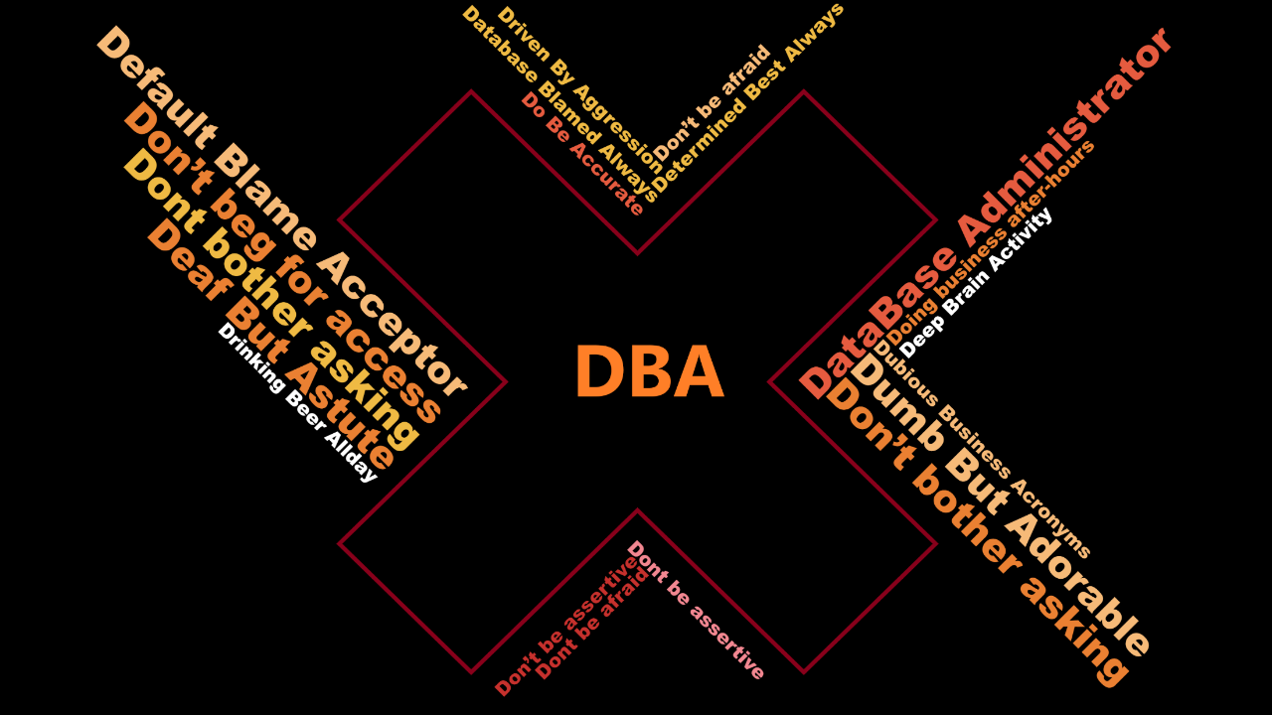

Slide 29
Document that can contain text, code, images and query results

Slide 30
PowerShell Conference EU
All the videos for the Virtual European PowerShell conference have been uploaded and are available for your viewing pleasure at
PowerShell.love

Slide 31

Time For A DEMO

Slide 32

Merci!
Prenez 2 minutes pour évaluer cette session (RDV dans l’espace de conversation)

Slide 33
Rob Sewell
Consultant
MVP and Beard Twizzler
@SqlDbaWithBeard
beard.media/book – 40 % code twitsewe40
Slides and Code beard.media/presentations
https://beard.media/Notebooks

